Slide 1
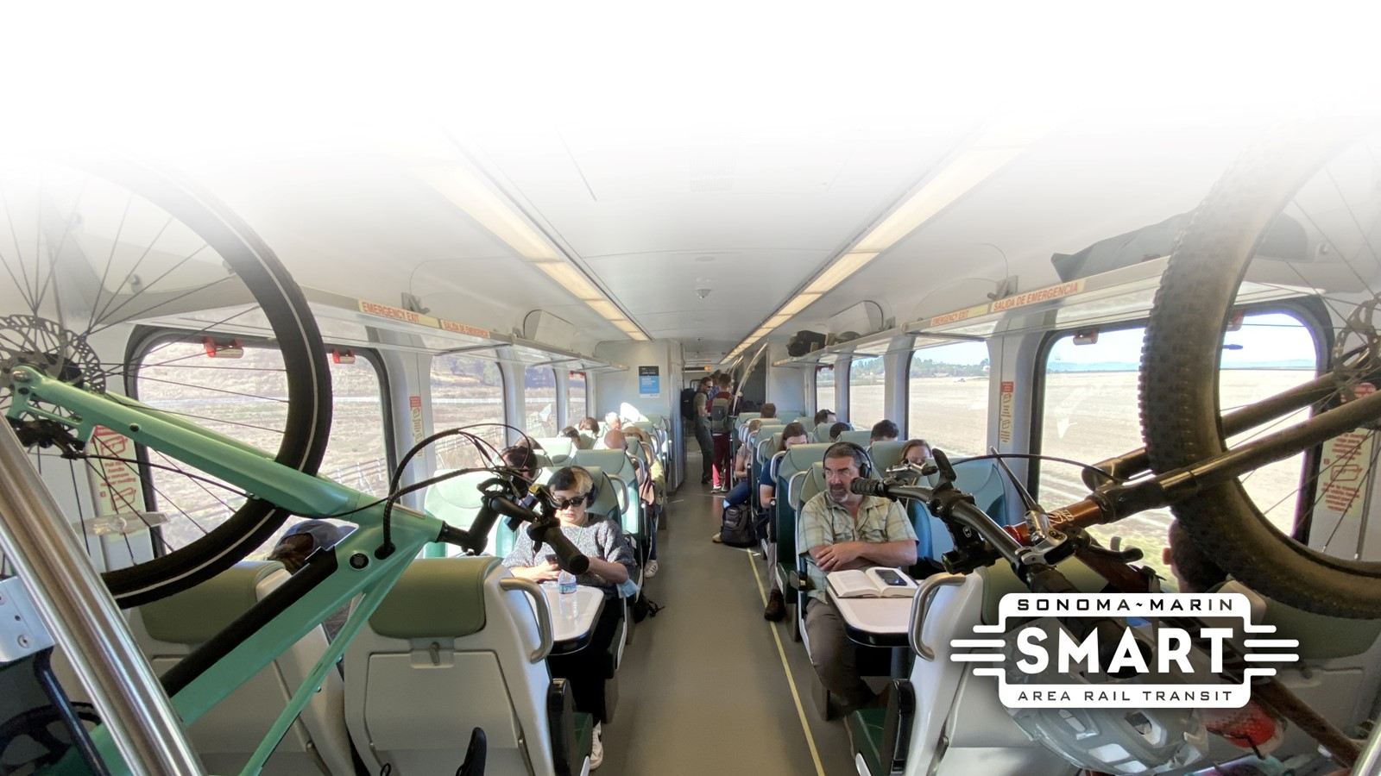
Agenda Item 11: FY25-FY30 Strategic Plan Final Draft

Slide 2

SMART Strategic Plan
Defines the strategic direction of the organization
Establishes goals, objectives, and actions in line with SMART’s vision and mission
Promotes collaboration, collective responsibility, and accountability
2019 Strategic Plan adopted in November 2019; updated every 5 years
New Strategic Plan: FY2025 – FY2030

Slide 3
2024 Strategic Planning Process
Refine Objective Areas
Goals
Strategies
Actions
Draft Strategic Plan
Final Strategic Plan
Outreach Process

Slide 4
2024 Strategic Plan Timeline
January
Community Workshop (Online): SWOT Analysis
Review Strategic Objectives
February
Community Workshop - Strategic Objective 1: Ridership
March
April – July
Community Presentations
August
Community Presentations
September - October
November - December
COC review Draft 2024 Strategic Plan – Nov 13
Community Workshop - Strategic Objective 2: Pathways
Community Workshop - Strategic Objective 3: Extensions
Community Workshop - Strategic Objective 4: Freight
COC Workshop – March 13, 2024
COC Workshop – August 14, 2024
Community Presentations and Public Open House
Draft Strategic Plan – posted Nov 8
Board Approval 2024 Strategic Plan – Nov 20 & Dec 18

Slide 5
Summary of Revisions to Plan
Added: Goal Statements to Executive Summary
Added: Expand outreach to seniors and persons with disabilities and provide information to organizations that provide services to these groups.
Added: Joint Marketing among North Bay Transit Agencies
Added: Explore adding solar panels at the Rail Operations Facility or other SMART-owned facilities
Revised Action: “Complete the environmental clearance and the preliminary engineering for the Puerto Suello Hill Pathway in San Rafael”
Revised Action: “Pursue addition of a Geyserville station halfway between Cloverdale and Healdsburg to enhance value of the investment in the railroad through northern Sonoma County”
Revised fare revenues to match ridership projections
Added text explaining fare policies that prioritize ridership over farebox recovery ratio, and the use of investment per passenger mile as a measure
Added Appendix C: Fiscal Scenarios beyond 2029

Slide 6
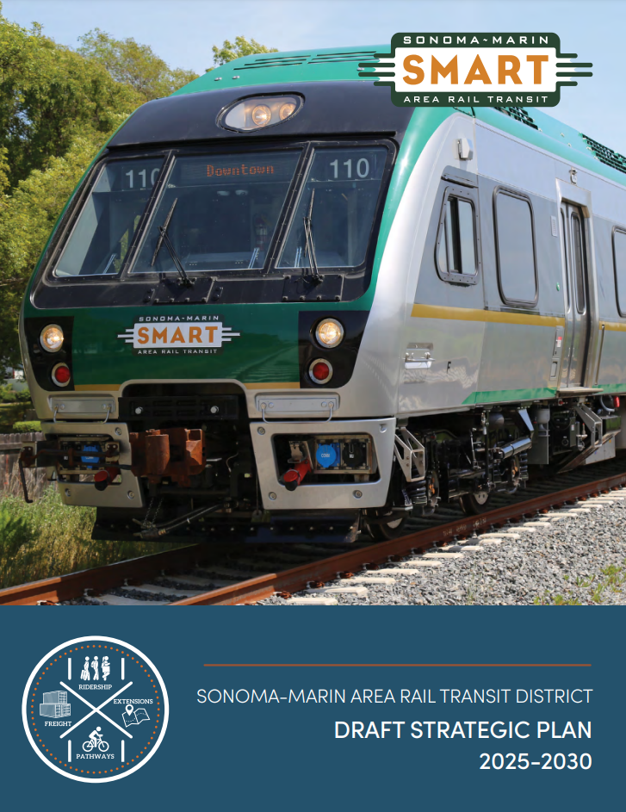
Final Draft Documents
Final SMART Strategic Plan 2025-2030
Appendix A - Outreach Summary
Appendix B - Revenues and Expenditures by Fiscal Year
Appendix C – Fiscal Scenarios beyond 2029
Posted online at: sonomamarintrain.org/strategic-plan

Slide 7
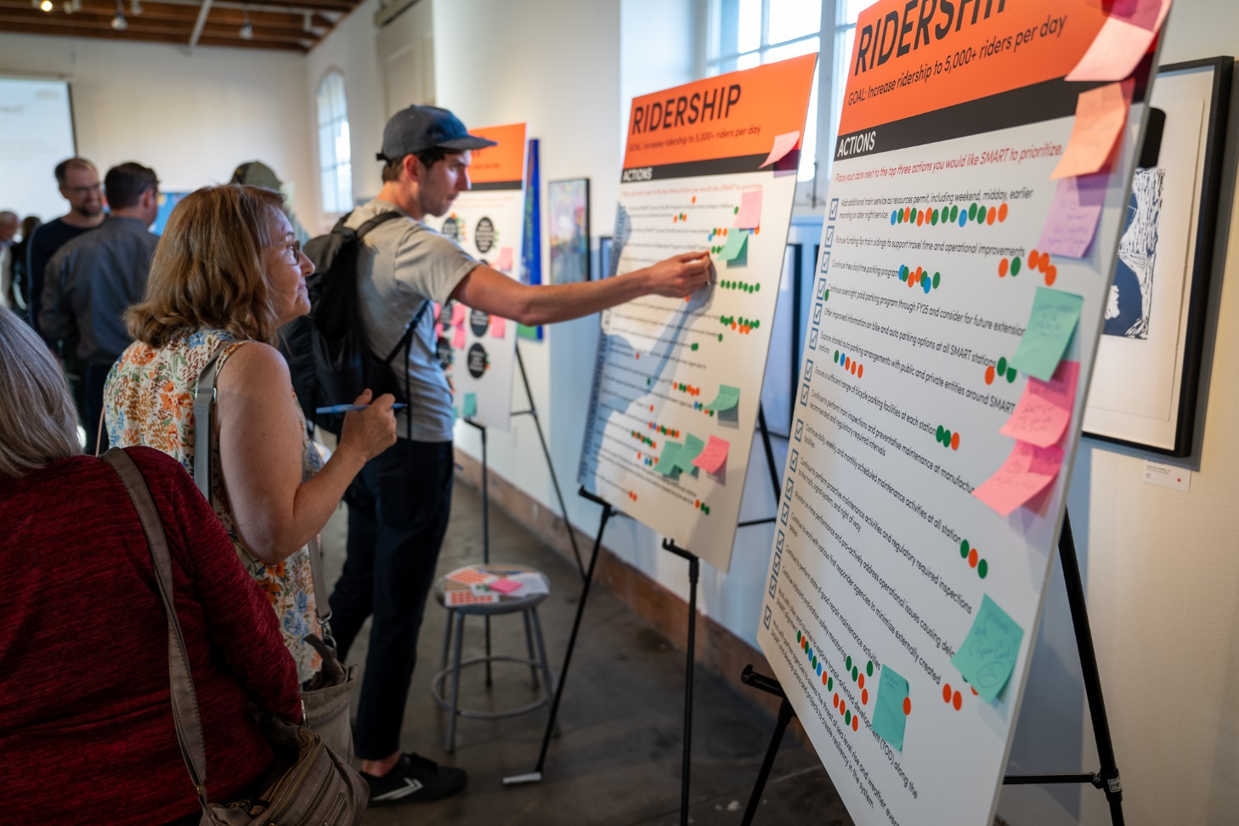
Recommendation: Adoption of the FY25-FY30 SMART Strategic Plan
Questions?

Slide 8
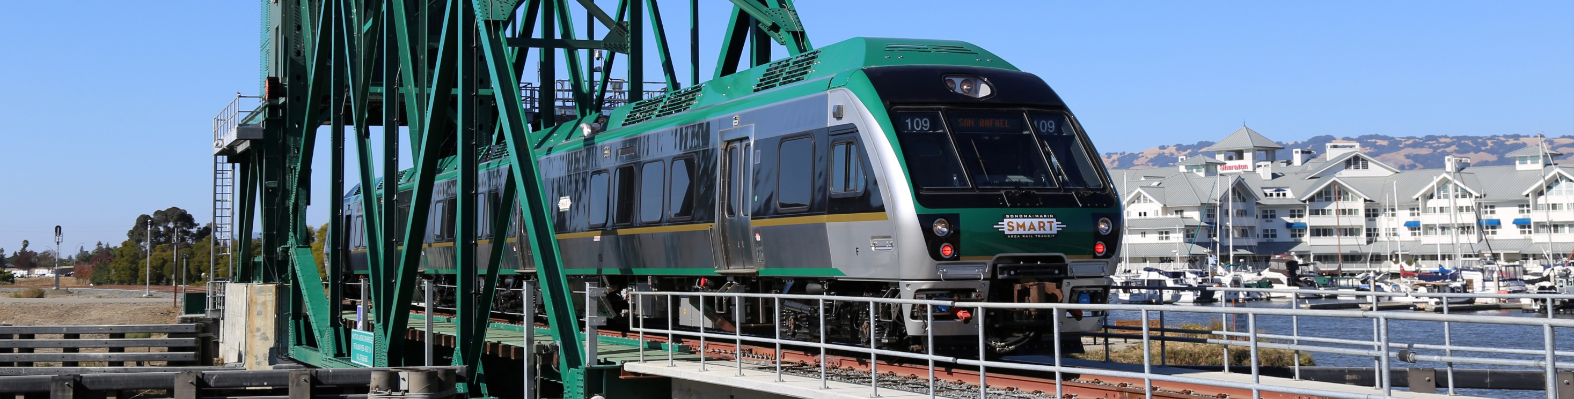

www.sonomamarintrain.org
Customer Service:
CustomerService@sonomamarintrain.org
(707) 794-3330
8

